Slide 1
Gerrit

Slide 2
Agenda
What is Gerrit?
Why Gerrit?
Code Review – Step by Step
Gerrit UI
Q & A

Slide 3
What is Gerrit?
Google Project developed Shawn Pearce specifically for Android Project
Web-based, FREE collaborative team code review tool
Git server – Control Repository
Gerrit makes code review easy by providing a lightweight framework for reviewing commits before they are accepted by the codebase.
Gerrit is used by many of the largest open source communities such as Android, Google Code, Eclipse Foundation and OpenStack, as well as many of the world’s largest enterprises such as SAP, Sony Ericsson, EA, Intel, NXP, Ericsson, Qualcomm.
Named after a Dutch Architect “Gerrit Rietveld”

Slide 4
Why Gerrit?
Interactive Code Review Process
UI available to see status of code changes and reviews
Integration with CI Tools
Gated Check-In Process

Slide 5
Gerrit Model Example with CI
DEVELOPER
GERRIT
REVIEWER
Create Branch
Make Changes
Push
Build
Deploy
Comment
Code Review
Score
No
PASSED?
Yes
Submit
GIT REPO

Slide 6
Why should we care about Gerrit?
Some of you might be thinking right now why bother doing this kind of process?

Slide 7
Benefits of Gerrit
Gerrit is like the “GATE” before the final push (Submit)
Build Pass is ensured
Deploy failure in main repo will not happen
Retains High Quality Code

Slide 8
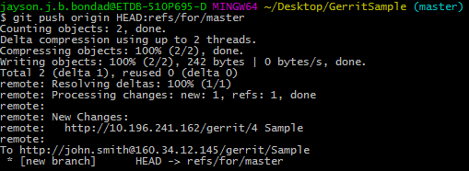
Gerrit Code Review Process – Step by Step
DEVELOPER
GERRIT
REVIEWER
Create Branch
Make Changes
Push
Build
Deploy
Comment
Code Review
Score
No
PASSED?
Yes
Submit
GIT REPO

Slide 9
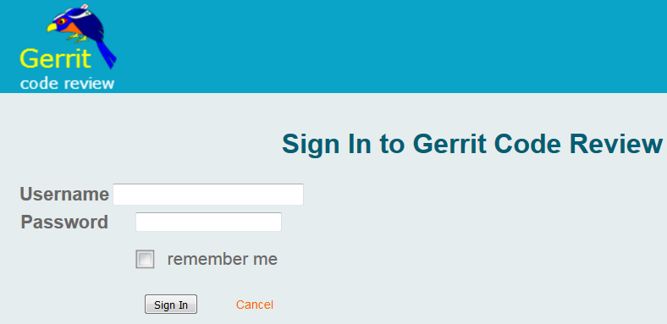
Gerrit UI – Login

Slide 10
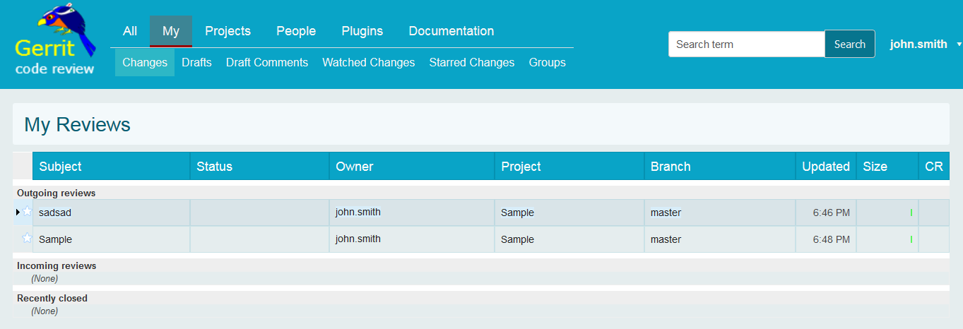
Gerrit UI – MyReviews

Slide 11
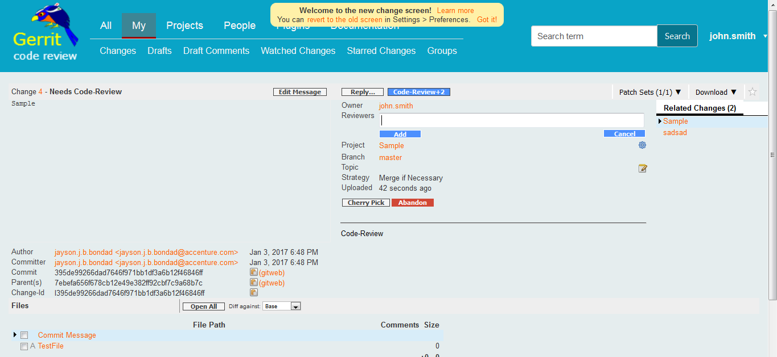
Gerrit UI – Adding code reviewer

Slide 12
Gerrit UI – Criteria for Submit

Slide 13
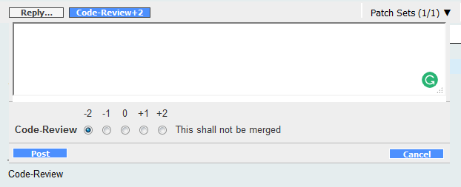
Gerrit UI – Criteria for Submit
Score | Description
-2 | This shall not be merged.
-1 | I would prefer this is not merged as is.
0 | No Score
+1 | Looks good to me, but someone else must approve
+2 | Looks good to me, approved

Slide 14
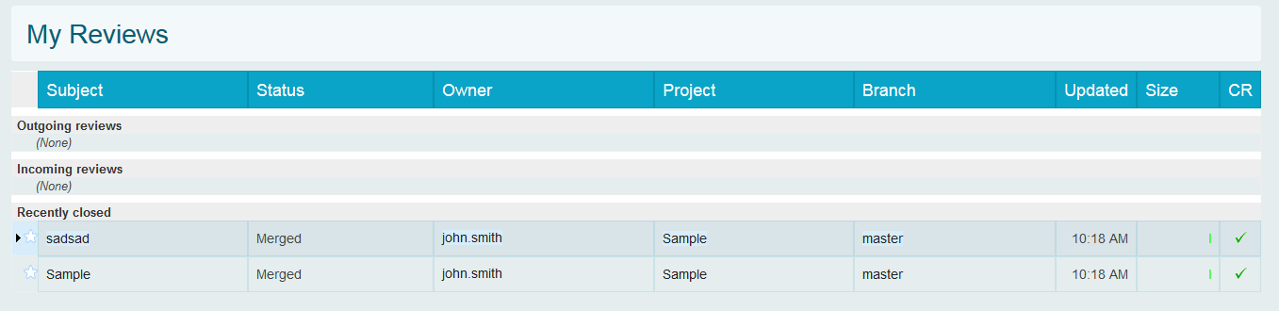
Gerrit UI – Criteria for Submit

Slide 15
Gerrit Terminology
TERM | DESCRIPTION
Change | A unit of review. Every commit will have unique change-id assigned to them.
Patch Set | A revision of change. The first revision is patch set 1.
Label | A rating category that allows or blocks progress of a change. (ex. Build, Deploy, Code Review).
Score | The rating given to a label. For some labels the range is -1 to +1 that allows or blocks. Code Review spans from -2 to +2.
Submit | Merges a change into the repository – until this happens, no changes is pushed to the main repo.
Abandon | Archives a change (can be restored later)
Project | A Git Repository

Slide 16
Creating and Uploading Contributions
Preparation
Before any contribution can be created, a Git clone of the target repository must be obtained and properly configured. The necessary steps are explained in Setting Up Gerrit.
Creating a New Contribution
All contributions are uploaded with a regular Git push. Gerrit handles reviews at the commit level. A single contribution can easily result in several reviewable Changes in Gerrit. The contributor prepares a contribution by following these steps:
Creating or updating the local repository
Optionally creating a topic branch
Creating commits
Uploading the commit(s) to Gerrit
Soliciting feedback

Slide 17
Gerrit UI Summary
Login to Gerrit
Menu / Sub Menus
What is my outstanding code reviews? (Step-by-Step where to find it in UI)
Outgoing Reviews
Incoming Reviews
How to look at the status under Label (ex. B,D,CR)
Add code reviewers
Flip through codes to be reviewed
Build and Deploy check with CI can happen automatically
Troubleshoot for build or deploy failure
Submit button
Difference between code review ratings.

